Slide 1

USDA-Africa Partnerships to Mitigate Aflatoxins
United States
Department of Agriculture
Office of Capacity Building and Development (OCBD)
Foreign Agricultural Service (FAS)
U.S. Department of Agriculture (USDA)
Ms. Elisa Loeser, M.A. Dr. Chris Peterson, PhD.
Intl. Program Specialist Intl. Program Specialist
Elisa.Loeser@fas.usda.gov Chris.Peterson@fas.usda.gov

Slide 2
USDA’s Role as a Connector
International Community & Donor Agencies
USDA
On-ground Partners

Slide 3

USDA/FAS Officers are RESOURCES
Global Network of Foreign Service Officers
93 Offices Covering 171 Countries
USDA/FAS Presence in Africa:
  Accra, Ghana
  Addis Ababa, Ethiopia
  Algiers, Algeria
  Cairo, Egypt
  Dakar, Senegal
  Nairobi, Kenya
  Pretoria, South Africa
  Rabat, Morocco
SPS Advisors
  Accra, Nairobi, Pretoria – covering West, East, & Southern Regions

Slide 4
Vision: Reduced Illnesses and
Increased Trade
Aflatoxin Mitigation Program
Goal: Improve food safety and human health by:
  Reducing aflatoxin incidence
  Building policy, regulatory, and technical capacities
Approach: Leverage on-ground public and private-sector partnerships to implement life-saving and trade-enhancing advances in agronomy, policy, and enforcement.

Slide 5
Biocontrol Development
Partners: University of Arizona, IITA
Mutual Recognition of efficacy data
Partners: University of Arizona, IITA
Regional
In-country
Policy Development
Partner: AATF, IITA
Product Registration, Mass Production
Trade & Standards Enforcement
Partners: North Carolina State University, AATF, COMESA
Reduced aflatoxin,
Increased trade

Slide 6
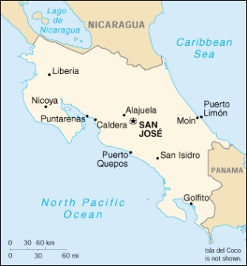
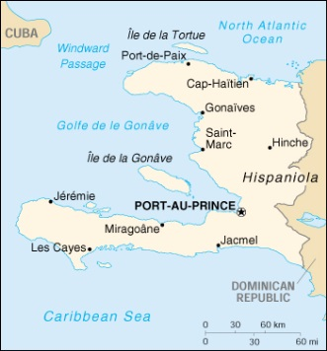
Biocontrol Development
Costa Rica
Senegal
Nigeria
AFLASAFE
The Gambia
Rwanda
Uganda
Kenya
Haiti
Burkina Faso
Burundi
Ghana
Tanzania
Malawi
Zambia
Mozambique
Strain development in progress
Products under testing in farmers’ fields
Product ready for registration
Area-wide registration of SN01 by CILSS
Product available
A member of CGIAR consortium
Map courtesy of IITA

Slide 7
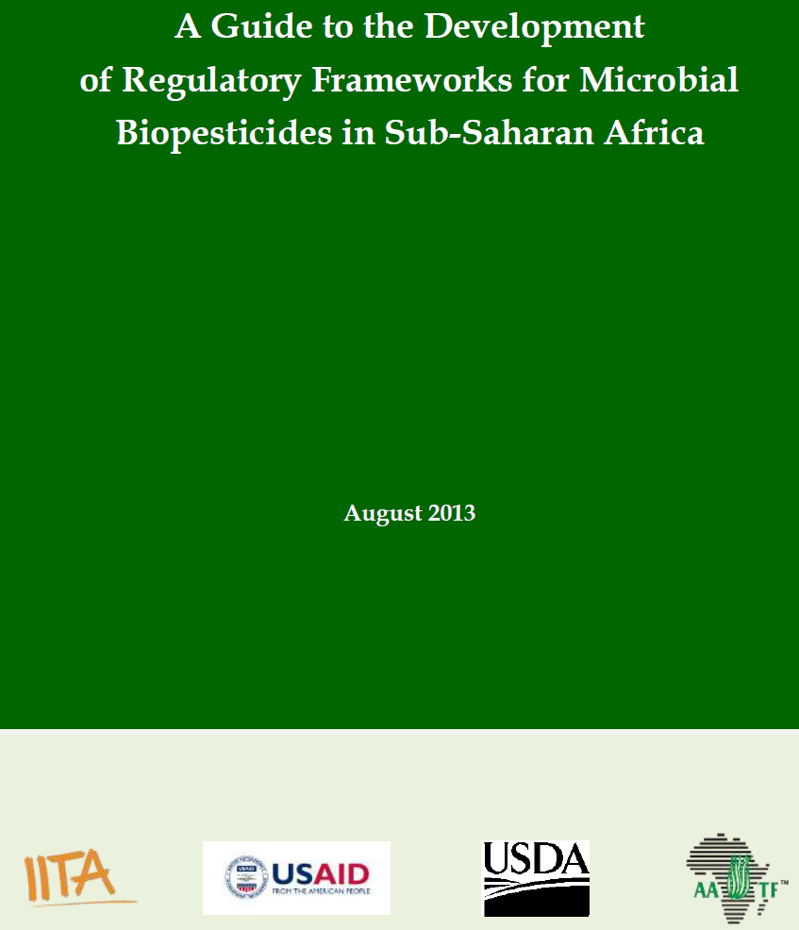
Policy Development
Biocontrol Registration
Biopesticide Registration Guidance Document
Provides roadmap to adoption of registration mechanism

Slide 8
Trade and Standards Enforcement
Sampling and Testing Protocols
Provide statistically valid, standardized tests for aflatoxins in maize and ground nuts

Slide 9






















