Slide 1





Case Study: Small Holder Farmer AFLASAFE Technology Adoption
Partners
Creating Companies | Creating Wealth | Creating Jobs
March 2014

Slide 2
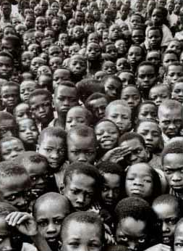
Our Challenge
Doreo

Slide 3
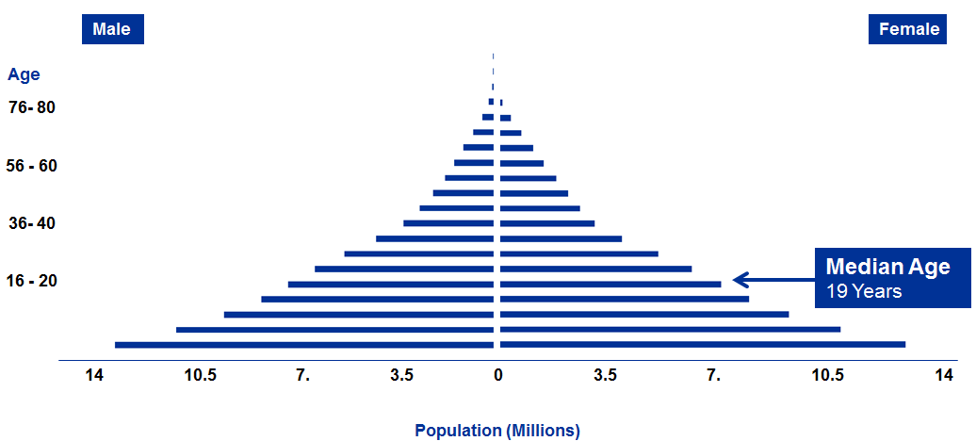
In Nigeria… We need to create 80 million jobs between 2010 and 2030
Notes:
3
3

Slide 4
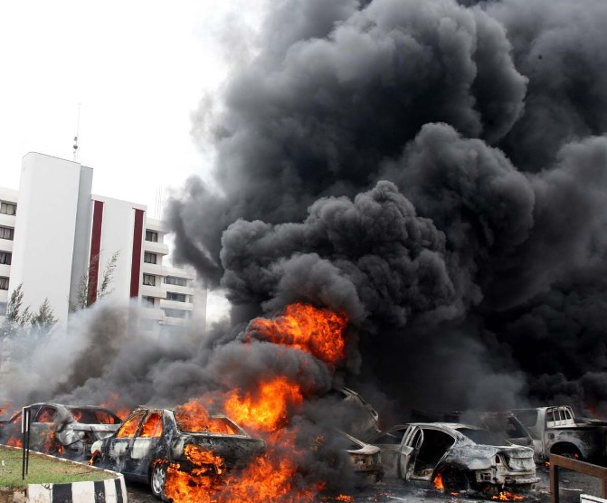
The Impact
The Impact
Doreo
17

Slide 5
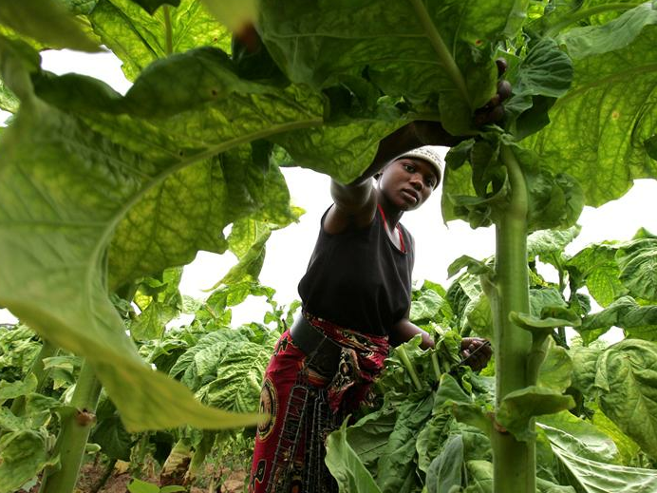
The Solution – Small Holder Agriculture
Nigeria's Job Creation Engine
40% of GDP
High Growth
Labor Intensive
Low Skill
18

Slide 6
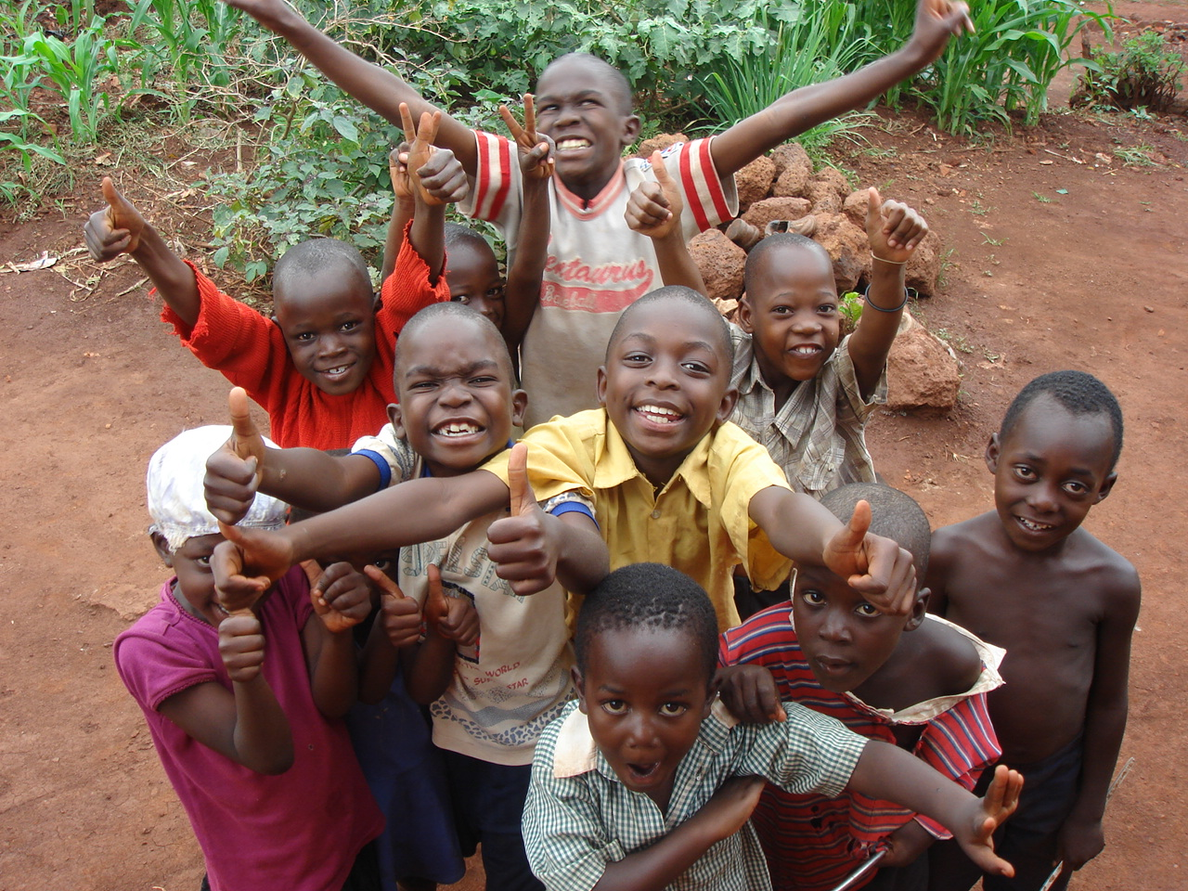
We believe…
Our continent is on a path to greatness, to stay the course we must create millions of needed jobs now
The fastest way to create these jobs is to invest in commercial and highly scalable business that improve the profitability and livelihoods of small scale farmers
Such investments will create market forces that will unlock millions of jobs

Slide 7

Why Aflasafe

Slide 8
Malaria – Aflatoxin Analogy
Malaria
1
Prevent Bite
2
Vaccine
3
Prevent Illness
After Bite
4
Cure Malaria
5
Segregate the Sick

Slide 9
Malaria – Aflatoxin Analogy
Malaria
Aflatoxin
1
25 Years of proven data
Ease of use / Broad cast it and forget it
Commercialization hurdles in Africa remain
Prevent Bite
Aflasafe
2
Vaccine
Breed Resistance
40 years and $100’s of millions spent with no useful resistant varieties
3
Prevent Illness
After Bite
Plant Stress
Complicated requiring small holders to execute multiple steps from planting through storage.
Complicated by multiple environmental variables
For 50 years struggle to get Small Holders to use fertilizer correctly
GAP
Storage
4
Cure Malaria
Amoniation
Not practical for human consumption
Expensive
Binders
5
Segregate the Sick
Sorting
A last resort
Not a solution for staple crops as it concentrates aflatoxin in diets of poor

Slide 10
Malaria – Aflatoxin Analogy
Malaria
Aflatoxin
1
25 Years of proven data
Ease of use / Broad cast it and forget it
Commercialization hurdles in Africa remain
Prevent Bite
Aflasafe
2
Vaccine
Breed Resistance
40 years and $100’s of millions spent with no useful resistant varieties
3
Prevent Illness
After Bite
Plant Stress
Complicated requiring small holders to execute multiple steps from planting through storage.
Complicated by multiple environmental variables
For 50 years struggle to get Small Holders to use fertilizer correctly
GAP
Storage
4
Cure Malaria
Amoniation
Not practical for human consumption
Expensive
Binders
5
Segregate the Sick
Sorting
A last resort
Not a solution for staple crops as it concentrates aflatoxin in diets of poor

Slide 11
How to get small holders to adopt new technology?

Slide 12
Create an integrated private sector solution that solves three hurdles of technology adoption
Access to Finance
High Cost Per Unit, Due to Low Yields
Access to Premium Markets
Low Economies of Scale

Slide 13

The Agricultural Franchise Model brings economies of scale to small holder farmers
Trust Group 1
Trust Group 2
Trust Group n
Small Holder Farmer
Members
Services
Small Holder Farmer
Members
Services
Services
Small Holder Farmer
Members

Slide 14
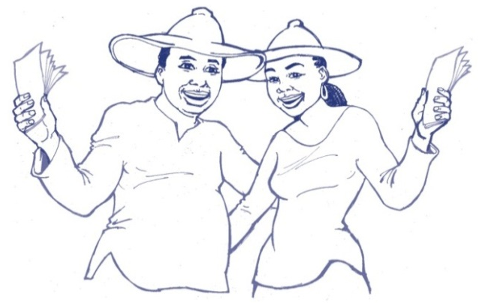
To Inspire and Enable Hardworking Small Holder Farmers Reach Their Full Potential
Training
Credit
Agric
Inputs
Good
Markets
14

Slide 15
Phase 1 Aflasafe Pilot Commercialization
Purchase Aflasafe
Repackage Aflasafe
Farmer Purchase Aflasafe for $15.60/ha
Farmer Produces Maize with Yields above 3.5MT/ha
Babban Gona Test Maize at Harvest
Maize passes test farmer receives $6.25/mt premium
Babban Gona markets maize for +$6.25 premium
1
3
5
2
4
6
7

Slide 16
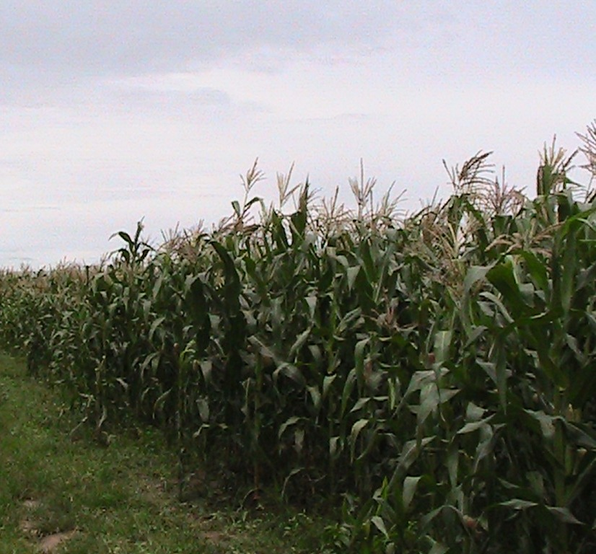
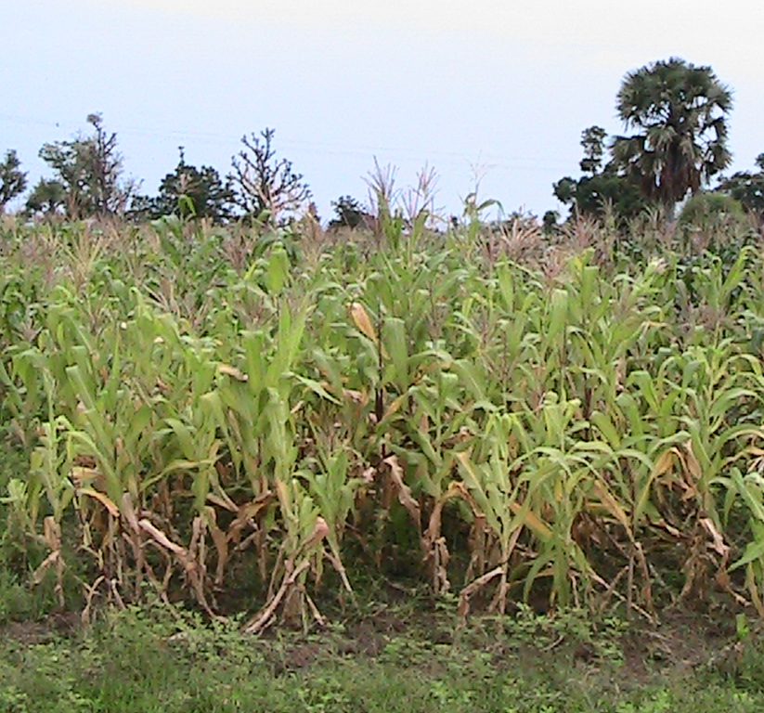
Profitably Producing Low Aflatoxin Maize
Double Farmers Incomes
Stuck In Poverty
Babban Gona Farm
Yields up to 6.9 tons per Hectare
Non Babban Gona Farm
Yields below 0.8 tons per Hectare

Slide 17
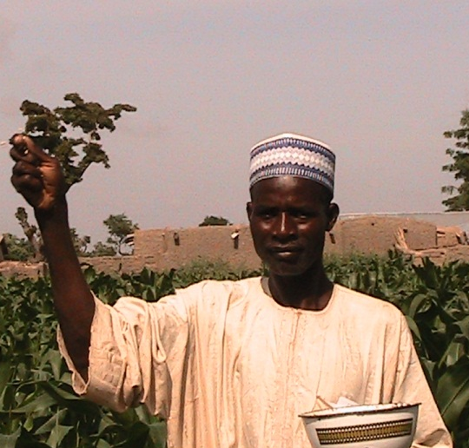
Increasing Incomes over $2,000 per Ha
50%
De-risked receiving credit at half the interest rate of conventional micro credit
19%
Discount on Inputs due to streamlined supply chains
400%
Yield Increase over national average
37%
Premium price for producing low aflatoxin products and streamlining supply chain
Doreo

Slide 18
Babban Gona: Inspire and enable 1 Million Farmers produce 4 million MT of Aflasafe Maize by 2025
Metric Tons of Aflasafe Treated Maize
Development Phase
Refine model in Northern Kaduna
Regional Expansion
Scale model across Nigeria
Organic Growth Phase
Each Trust Group recruits one new Trust Group every 2 years.
Notes:
When you hit big numbers.

Slide 19
Strategic Plan to Drive Sustainability
Leverage Strong Regulatory Enforcement to Sustain Premium Market for Aflasafe maize
1
Generate Supply of Cost Effective Low Aflatoxin Maize
PACA and Pull Mechanism
2
Enforce Regulatory Policy
Policy: Build Regulators Capacity
Policy: Develop regulatory framework
Policy: Phased in regulatory enforcement mechanism
3
Enable Market Forces to Drive Sustainability
Market Forces
Promote Health Awareness to Value Chain Actors
4
Health Awareness: Farmer Focus
Health Awareness: Industry Focus
Health Awareness: End Consumer
1
2
3
4
5
Year

Slide 20
Contact Details
Lagos
3B Baajiki Close
Lekki Phase I
Lagos, Nigeria
London
11 Mount Pleasant
London, England
SE27 9PU
Kola Masha
Managing Director
kola.masha@doreopartners.com
+234-(0)-805-5000-350
www.doreopartners.com
Doreo

