Slide 1
Aflatoxin awareness creation in West Africa Application of principles and best practices of risk communication
Rose Omari
EATSAFE, Ghana /
Science & Technology Policy Research Institute

Slide 2
Outline
Evidence of aflatoxin contamination in W/A
Principles of food safety risk communication
Some aflatoxin awareness creation activities in W/A
applied principles of risk communication????

Slide 3
Evidence of aflatoxin contamination in W/A 1
Ghana, Nigeria, Senegal, Togo, and Burkina Faso have recorded aflatoxin contamination in sorghum, maize, cotton seeds, groundnuts and groundnut products, yams, and cassava at varying levels with levels usually > EU and USDA standards (USAID and Danya International, 2012).
A study in Ghana reported total aflatoxin levels in maize ranging from 2 ppb to 662 ppb (Kpodo 2000).

Slide 4
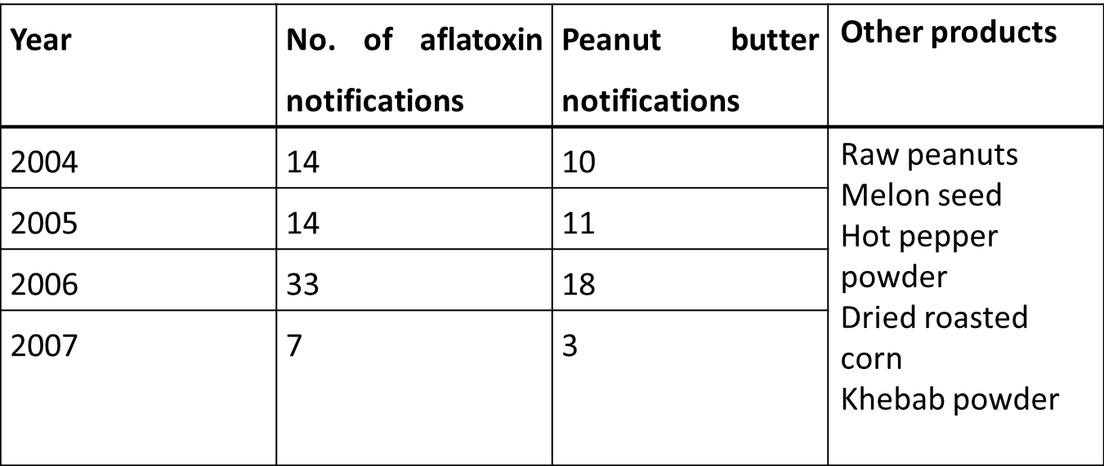
Evidence of aflatoxin 2
Alert notification concerning aflatoxin in Ghana’s exports

Slide 5
Evidence of Aflatoxin 3
Based on EU alert notifications the ff levels have been detected in peanut butter exported from Ghana.
NB: Maximum total afla levels: Ghana standards GS 49:2003 = 4ppb, EU-(EC) No 1881/2006 = 4ppb, 2ppb for afla B1
Source: Compiled from Rapid Alert System for Food and Feed (RASFF)
Year | Export rejects
 | Aflatoxin B1 (μg/kg or ppb) | Total Aflatoxin (μg/kg or ppb)
Oct. 2007 | 95.5 | 135.9
March 2009 | 194 | 226
June 2009 | 2.9 | 3.9
June 2009 | 3.2 | 4.2

Slide 6
Due to the numerous notifications concerning aflatoxin in peanuts and its products EC to carry out a mission in Ghana in September 2007 to assess the official control systems in place to control aflatoxin contamination in peanuts and peanut products.

Slide 7
Importance of Raising Awareness
Major challenge for aflatoxin control is low level of awareness among stakeholders
PACA and ECOWAS strategies for aflatoxin control have all emphasized the need for raising awareness among all stakeholders including farmers, consumers, extension workers, health professionals, and policy and decision makers.
The goal of PACA’s theme 5, ‘public awareness, advocacy and communication’ is to increase awareness of the impacts of aflatoxins and its mitigation measures.

Slide 8
Raising Awareness
Essentially, we want to make a compelling case to policy makers, investors and other stakeholders on the socio-economic and health benefits of aflatoxin mitigation and control.
To do this requires the application principles and best practices of food safety risk communication.

Slide 9
Principles of food safety risk communication
Purpose of food safety risk communication
Provide people with information about the risk, what is being done to manage it, what people can do to protect themselves and others from risk
Persuade people to adopt a particular approach (e.g., mitigation measures) ; or
Initiate dialogue and engagement to improve the risk analysis process and arrive at the best approach

Slide 10
Principles of risk communication.
Availability of information and scientific evidence
take into account expert advice, stakeholder input and consumers’ interest, concerns and background.
Openness
being open means
to communicate in a plain language and without hiding information.
to be prepared to consider input from other stakeholders in a way that allows scrutiny and maintains independence whilst respecting legitimate concerns about confidentiality.

Slide 11
Principles of RC
Transparency
Being transparent means:
to explain issues for stakeholders and the target audience to understand the contexts and take appropriate actions.
Transparency often involves
communicating clearly about uncertainties (when all facts are unclear)
whether and how these uncertainties can be addressed and
the implications of these uncertainties for public health, economy and agric.

Slide 12
Principles of RC
Credibility
It is reinforced if consistent messages are received from multiple sources
Factors that determine source credibility include:
recognized competence or expertise,
trustworthiness,
fairness, and
lack of bias.
Most audiences have associated high credibility with terms such as factual, knowledgeable, expert, public welfare, responsible, truthful, and good "track record".

Slide 13
Principles of RC
Responsiveness and timeliness
Communicating in a timely and accurate manner, including uncertainties or gaps in present knowledge will
Protect public health
contribute to building and maintaining credibility and trust and
Prevent any void being filled with rumours & misinformation.
Responsiveness means
listening to public concerns;
Understanding the needs and expectations of the audience and where relevant address them.
Engaging with stakeholders from a very early stage to assist with the development of timely and relevant messages

Slide 14
Principles of RC
Dialogue and stakeholder engagement
Understanding the needs of relevant stakeholders and target audiences enables messages to be tailored thus maximising their effectiveness.

Slide 15
Other factors to consider in risk communication
Nature of hazard
Who/what is affected
Level of risk and level of exposure
Ability to control the risk
Level of communication required
Communication channels and tools
the choice of communication channels should be based on
the goal of the risk communication (e.g. interactive)
the content or nature of the message (e.g. urgency) and
their availability and accessibility to target audiences.
No one channel of communication may be adequate. Combine various methods as much as possible

Slide 16
Other factors
Interacting with the media
Effectiveness of media interaction can be increased by:
Being proactive.
Identifying and targeting the media outlets that serve the target audiences, and tailoring media materials for them.
Coordinating the media responses with stakeholders whenever possible.
Considering various methods for reaching media audiences (e.g. regular news conferences, teleconferences, webcasts, news/press releases, online content, social media channels, etc.)
Monitoring media coverage closely and correcting errors or misleading coverage as quickly as possible.

Slide 17
Other factors
message development
Messages should state
the severity of the risk and the audience’s vulnerability to it
what is being done to manage the risk, and
empower the audience to prevent the risk where possible.
Collaborating and coordinating with credible information sources
Infuse food safety risk communication into policy/decision making process

Slide 18
Some awareness creation efforts in W/A
Two cases
Aflatoxin risk communication by the Food Research Institute (FRI) of Ghana and Ghanaian media from 1998 to 2000
Aflatoxin campaign carried out by Rotary Clubs and stakeholders in Ghana, Togo and Benin

Slide 19
FRI/Media awareness creation
Excerpts from media publications
‘Kenkey causes cancer-how to minimise it’ (Ghanaian Chronicle, August 17-18, 1998). Excerpts:
Scientific studies conducted from major processing sites and markets in Accra have concluded comprehensively that there is a widespread occurrence of a toxin that causes cancer in kenkey.
The Food Research Institute (FRI) scientists who conducted the research, have so far limited the circulation of the report, which is treated confidentially, fearing that reckless leakage of the findings could cause widespread panic among the public since kenkey is eaten by more than half of the population.
Scientists at the FRI last Tuesday grudgingly acknowledged the information but insisted that the information should not be "sensationalised" since it could cause panic.

Slide 20
FRI/Media
‘Fufu, gari can also cause cancer - Food Research Institute’ (Ghanaian Chronicle October 19, 1999). Excerpts:
Fears raised by the Ghanaian Chronicle a year ago that some local foods prepared from grains, especially Kenkey, contained aflatoxin which can cause cancer has been confirmed.
Acting Director of the FRI confirmed this during a visit to the institute by the Minister of Environment, Science and Technology last Tuesday.
‘Kenkey, fufu, gari, konkonte, sorghum and groundnuts, all national staples, contain aflatoxins which can cause cancer," he emphasised.
He said the rise in the incidence of cancer deaths recorded at Korle-bu hospital in recent times could be attributed to aflatoxins.

Slide 21
FRI/Media
‘Food Research Institute denies Kenkey cancer story’ (Joy Online, October 26, 1999). Excerpts:
Acting Director of the FRI, a food scientist, has described a publication attributed to him that Kenkey, Fufu and Gari can cause cancer as untrue and alarmist. He said aflatoxin contamination is real but that there is no empirical evidence based on a research in Ghana to definitely establish a direct link of an incidence of cancer to any particular food.
He said "No aflatoxin has ever been determined in fufu or gari in our laboratories and I have never come across any such report in the literature on the subject.“
He denied having said that aflatoxin might be the cause of many cancer cases recorded at the Korle-Bu Teaching Hospital in the past few months. “We have no reports and we are not in position to determine the causes of any form of cancer, much less specifically relate the consumption of certain aflatoxin-contaminated foods to cancer-related deaths.
He said “Ghanaian staple foods are safe under the current steps being taken by relevant organizations to ensure good post-harvest management practices”.

Slide 22
Rotary Campaign 2001-2004: Highlights
Aflatoxin awareness campaign conducted in Ghana, Togo and Benin.
First conducted a public opinion survey in 2000 to guide the development of the campaign
Organized sub-regional stakeholders’ workshops to develop the campaign theme, messages, approach, and promotional materials
Stakeholders agreed on the campaign theme “Quality maize for better health: this is a message from Rotary International”.
In Ghana, ‘mouldy maize’ was adopted as a proxy for aflatoxin contamination
Entire campaign focused on mouldy maize

Slide 23
Rotary campaign
Incorporated location-specific scientific data on aflatoxin incidence and management strategies into campaign messages
Message was targeted at specific audiences (farmers, traders, processors, milers, consumers etc.)
Message emphasised some mitigation measures

Slide 24
Ref.
James et al. (2007) Public information campaign on aflatoxin contamination of maize grains in market stores in Benin, Ghana and Togo. Food Additives & Contaminants, 24:11, 1 - 9
http://dx.doi.org/10.1080/02652030701416558

Slide 25
Evidence of Good practices of RC
Principle of risk communication | Evidence of application
Trust, Openness, transparency, honesty | FRI published findings in a scientific journal. Denied subsequent media reports. Rotary campaign did not give target audience all the information. They focused only on mouldy maize.
Credibility | FRI & media lacked credibility due to conflicting reports in the media. Rotary campaign clarified matters to some extent.
Responsiveness and timeliness | The FRI scientists were not responsive and so did not share findings with relevant stakeholders e.g., regulatory authorities, public. Rotary campaign was responsive and timely. It lessened public concerns and confusion from previous media reports.
Dialogue and stakeholder engagement | FRI was not proactive in interacting with the media . Rotary involved stakeholders (maize farmers, market traders, consumers, poultry farmers, feed mill operators, media houses, and national policy/decision-makers concerned with agriculture, health and trade), IITA and Rotary Clubs in Benin, Ghana, and Togo at the early stages of the campaign.

Slide 26
Evidence of Good practices of RC
Principles of RC | Evidence of application of good practices of RC
Message development | Poorly done by FRI & media. -Rotary campaign message was based on science and best practices in aflatoxin control. Uncertainties were not handled properly by the campaign. Focus was on mouldy maize hence target audiences were not informed that non-visibly mouldy maize, processed maize products or other foods could also be contaminated with aflatoxin. Cultural and social sensitivity were considered- In Ghana, ‘mouldy maize’ was adopted as a proxy for aflatoxin contamination to avoid scaring the public away due to 1998/99 publications Local languages was used to deliver the messages thus helping in getting the information across various segments of the population. Message did not indicate to traders alternative uses (if any) of mouldy grains. The result is that mouldy grains are likely to remain in the food chain, e.g., they can be processed into maize flour, maize dough (for kenkey or banku) or roasted and milled into flour.

Slide 27
Principles of RC | Evidence of application
Communication Channels | The Rotary campaign used a combination of channels including Promotional material (e.g., t-shirts and caps, car stickers), Television & radio broadcasts, live role-plays, interpersonal contacts at social centres; community workshops, focus group talks with opinion leaders; National aflatoxin quiz competition in schools

Slide 28
Evidence of Good practices of RC
Infuse RC into policy/decision making process | Not done. After the Rotary campaign there has not been any national aflatoxin awareness programme in Ghana. However, some activities are on-going to address the contamination in products meant for export. This is likely to have a positive impact on the export markets but unlikely to benefit the Ghanaian public. ECOWAS aflatoxin control strategy seeks to Design country awareness creation strategies and harmonize them across the region. Promote discourse and communication through country and regional workshops. Conduct policy advocacy at country level. Create and formalize national Mycotoxin Associations as an instrument of awareness raising among the general public as well as interaction among stakeholders (already in Nigeria). Establish a West African Aflatoxin Awareness Day.

Slide 29
CONCLUSION
Getting risk communication right is necessary to ensure that all stakeholders
behave in ways that promote food safety, public health, food security and trade
accept economic, political, technological, behaviour or legal changes that are deemed necessary

Slide 30
“Knowledge about safe food handling does not decrease the risk for foodborne illness —applying safe food handling practices does.”
Dr. Angela Fraser
Thank You

