Slide 1
Challenges from Aflatoxin – The Case of NASFAM
Presentation at the COMESA Regional Workshop on Aflatoxin Challenges in Eastern and Southern Africa
11th – 13th March 2014, Golden Peacock Hotel, Lilongwe
Presenter: – Alexander Chikapula, Acting Commercial Director, NASFAM

Slide 2
Presentation Outline
Brief History of NASFAM
Aflatoxin challenge for smallholder farmers
Trade impacts of Aflatoxin
Market management based on Aflatoxin regulation
Market Access trends by Volume
Aflatoxin Management Interventions
Challenges in mitigating Aflatoxin risk

Slide 3
Brief History of NASFAM
1994 USAID funded Smallholder Agri-business Development Project (SADP)
1997 NASFAM emerged, intensified crop diversification and market access
Legumes introduced to spread risk of overdependence on Tobacco and Maize based systems.
Current membership of over 110,000 smallholder farmers in 50 Associations across Malawi
Currently guided by SDP III – Transforming Association Management Centres (AMCs) to Innovation and Productivity Centers (IPCs)

Slide 4
Aflatoxin Challenge for Smallholders
Food security of smallholders
- Maize and Groundnuts major part of rural diet.
Health of smallholders
- Farm productivity
Trade
- Local and international regulations
- Restricted market access

Slide 5
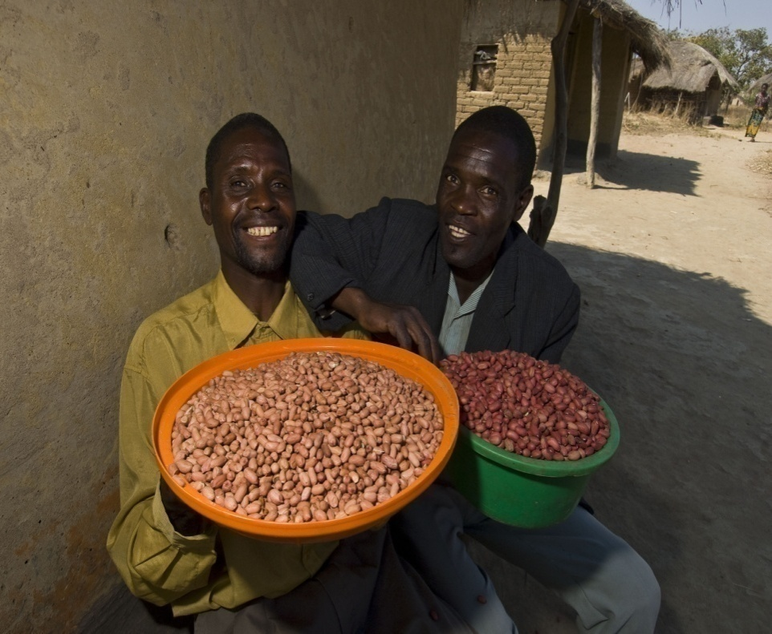
Trade impacts of Aflatoxin
Until mid 1980s, Groundnuts was Malawi’s third rated cash crop
Malawian groundnuts were liked in Europe due to their confectionary characters
Market was lost due to Aflatoxin infestation, among other reasons

Slide 6
Various markets’ regulations for Aflatoxin
Market | B1 | Total
European Union | 2 ppb | 4 ppb
South Africa | 5 ppb | 10 ppb
United States of America | 10 ppb | 20 ppb
Japan | 0 ppb | 0 ppb

Slide 7
NASFAM Market Management Based on Aflatoxin Regulation
Aflatoxin (µg/Kg) | Target Market | Importer’s Regulatory Limit
ND to 2.0 | Europe | 4.0
2.1 to 8.0 | RSA | 10.0
8.1 to 15.0 | Caribbean/USA | 20.0
≥ 15.0 | Local Market and other informal Exports | Unlimited
Grade Outs | Oil Extraction | Unlimited

Slide 8
Market Access Trends by Volumes
Year | Total Traded (MT) | Total exported (MT) | % Exported
2004 | 2,131 | 786 | 36
2005 | 350 | 160 | 46
2006 | 500 | 184 | 36
2007 | 2,160 | 956 | 44
2008 | 1,410 | 352 | 25
2009 | 740 | 146 | 20
2010 | 1,300 | 40 | 3

Slide 9
Aflatoxin Management Interventions
Improved farm management systems
Removal of visibly contaminated peanuts
Aflatoxin analysis (AfB1 {ELISA}, and Total Afla {VICAM})
Movement from hand sorting to machine sorting
Field demonstration of Mandela Cork drying technology

Slide 10
Aflatoxin Management Interventions cont’d
Hand Picking and Selection (HPS)
Machine Sorting
Electronic Eye Sorter
Illuminated Belts

Slide 11
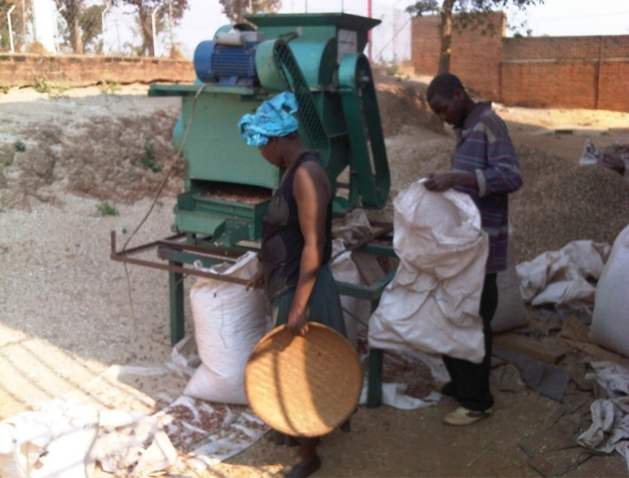
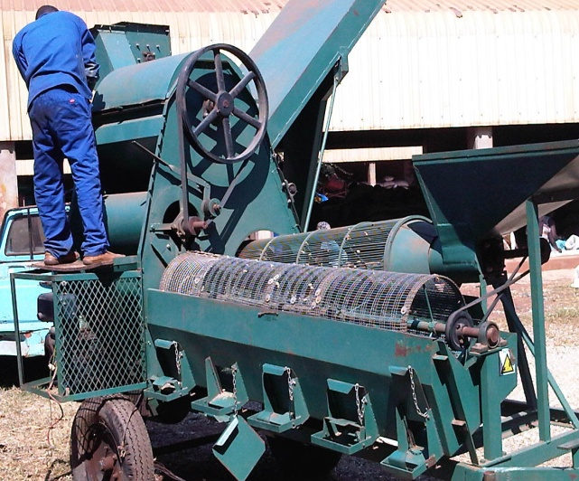
Aflatoxin Management Interventions cont’d
Mechanized groundnut shelling to prevent wet shelling
Shifting to buying unshelled groundnuts

Slide 12
Challenges in Mitigating Aflatoxin risk
Unavailability of suitable Aflatoxin detection technologies at farm and warehouse
Lack of appropriate shelling technologies
High cost of equipment and testing
Free for all buying system at farm gate
Developing appropriate messages and sensitization of producers and other value chain actors
Lack of harmonized regional standards

Slide 13
THANK YOU

